Slide 1
Enterprise Architecture of Pyaterochka
Graduate School of Business
Business Analytics and Big Data Systems
Enterprise Architecture Perfecting
Final Presentation
Moscow 2022
Prepared by Kalachinova Maria, Nefedov Alexander, Piskaeva Zlata, Vyazhev Daniil, Yuanyuan Yu

Slide 2
SWOT
Graduate School of Business
Business Analytics and Big Data Systems
Enterprise Architecture Perfecting
Final Presentation
Enterprise Architecture of Pyaterochka

Slide 3
Business Model Canvas
Graduate School of Business
Business Analytics and Big Data Systems
Enterprise Architecture Perfecting
Final Presentation
Enterprise Architecture of Pyaterochka

Slide 4
Motivation Model
Graduate School of Business
Business Analytics and Big Data Systems
Enterprise Architecture Perfecting
Final Presentation
Enterprise Architecture of Pyaterochka

Slide 5
Capability Heat Model
Graduate School of Business
Business Analytics and Big Data Systems
Enterprise Architecture Perfecting
Final Presentation
Enterprise Architecture of Pyaterochka

Slide 6
Capability Model
Graduate School of Business
Business Analytics and Big Data Systems
Enterprise Architecture Perfecting
Final Presentation
Enterprise Architecture of Pyaterochka

Slide 7
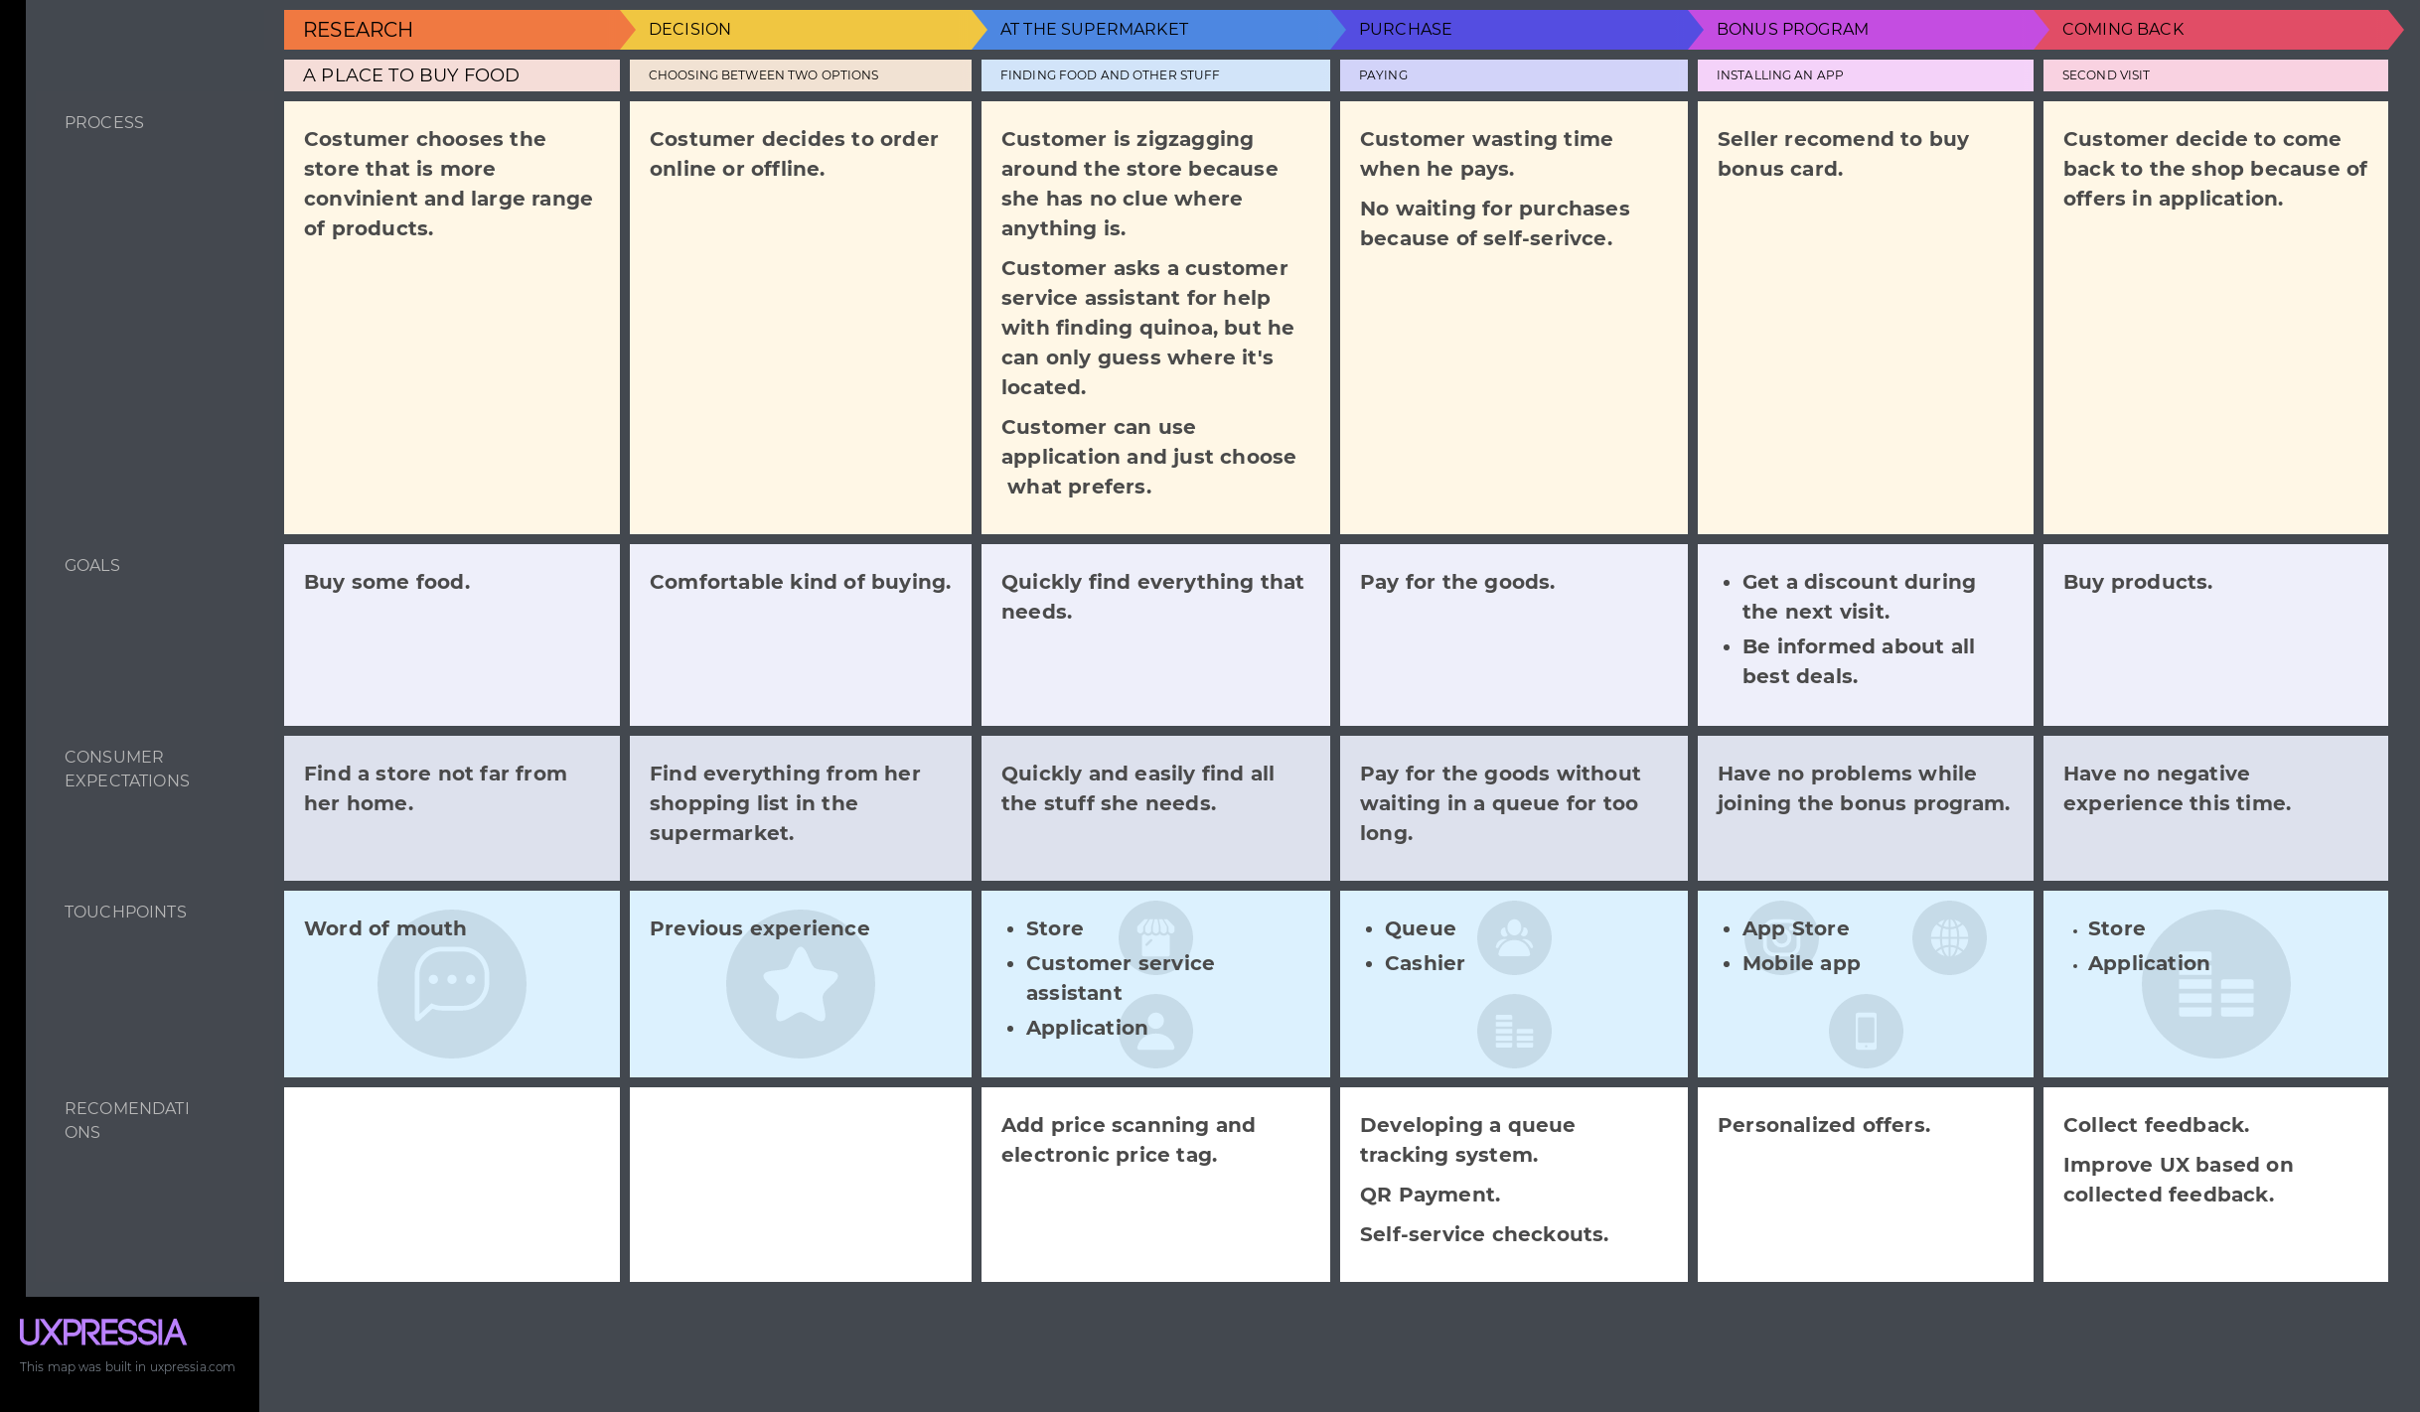
Customer Journey
Graduate School of Business
Business Analytics and Big Data Systems
Enterprise Architecture Perfecting
Final Presentation
Enterprise Architecture of Pyaterochka

Slide 8
Business Architecture
Graduate School of Business
Business Analytics and Big Data Systems
Enterprise Architecture Perfecting
Final Presentation
Enterprise Architecture of Pyaterochka

Slide 9
Application Architecture
Graduate School of Business
Business Analytics and Big Data Systems
Enterprise Architecture Perfecting
Final Presentation
Enterprise Architecture of Pyaterochka

Slide 10
Technical Architecture
Graduate School of Business
Business Analytics and Big Data Systems
Enterprise Architecture Perfecting
Final Presentation
Enterprise Architecture of Pyaterochka

Slide 11
Implementation Model
Graduate School of Business
Business Analytics and Big Data Systems
Enterprise Architecture Perfecting
Final Presentation
Enterprise Architecture of Pyaterochka

Slide 12
Thank you for your attention

